Slide 1
Card Layout
Switching between panels

Slide 2
Card Layout
A card layout allows you to change the look of the frame easily. If I want a new window to appear on a click I would use a card layout.

Slide 3
How it works
Essentially we create individual JPanels for each window that you would like to be capable of displaying. These are called your cards.
You create one JPanel whose sole purpose is to hold all of the cards. This JPanel will have its layout set to a CardLayout object.
Once you create all of the cards, you add them to the overall panel with a second parameter, a String for a name
Call the show(overall panel, String name of card) to display an individual card.

Slide 4
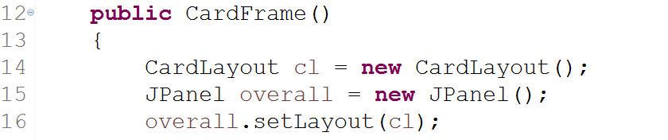
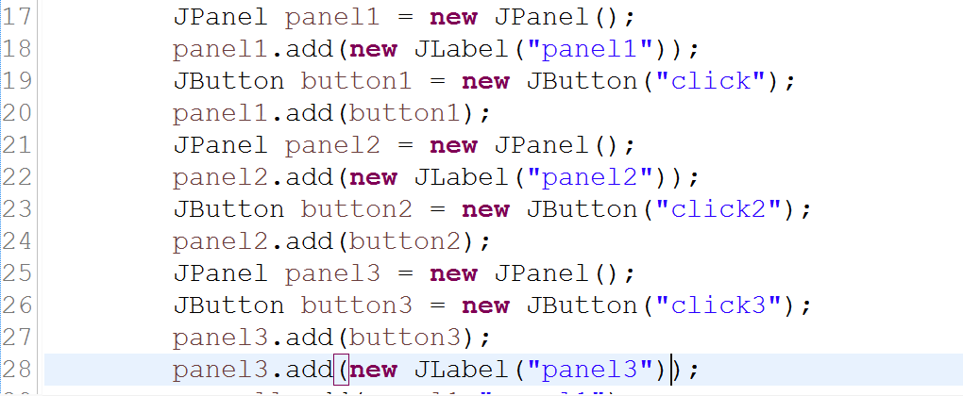
Simple example
Here I have created the CardLayout object and my overall panel which will hold all of my “cards”.
Then I just created
3 JPanels

Slide 5
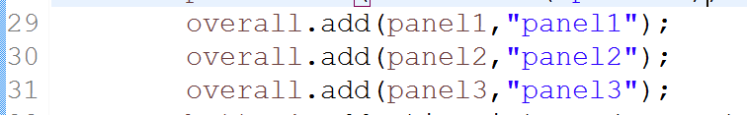
Add the “cards” to the overall panel
Here I just added the different panels to the overall panel. Notice that each has a string as a second parameter. That string is how I will identify them when running the show() method
String for name or identifyer.
Doesn’t have to match variable name.

Slide 6
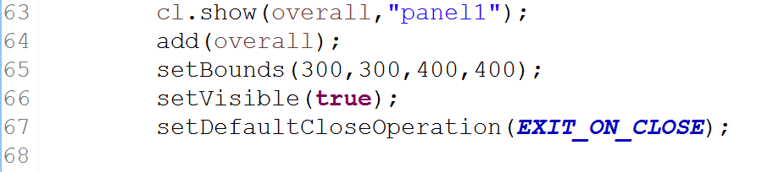
Setting up the Jframe
Run the show method on the CardLayout object to determine which “card” will be visible in the beginning and add the overall panel to the frame.
First Parameter:
Identifies which Panel will display the card.
This is our overall panel
Second parameter:
Identifies which “card” to show

Slide 7
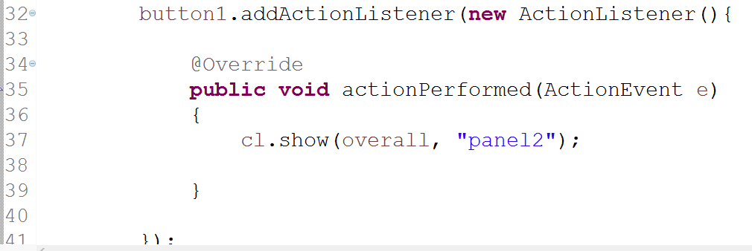
Add action listeners to toggle between “cards”

